Slide 1
Introduction to Deep Learning
Radu Ionescu, Prof. PhD.
raducu.ionescu@gmail.com
Faculty of Mathematics and Computer Science
University of Bucharest

Slide 2
What is this class about?
Some of the most exciting developments in …
Machine Learning, Vision, NLP, Speech, Robotics & AI in general
… in the last decade!

Slide 3
Instructors
Lectures:
Radu Ionescu (raducu.ionescu@gmail.com)
Labs:
Diana Grigore (diananicoletagrigore@gmail.com)
Vlad Hondru (vlad.hondru25@gmail.com)
Website:
https://deep-learning-fmi.github.io/DL/
Team code: bu4io8t

Slide 4
Prerequisites
Practical Machine Learning
Classifiers, regressors, loss functions, normalization, MLP, gradient descent, etc.
Linear Algebra
Matrix multiplication, eigenvalues, etc.
Calculus
Multi-variate gradients, Hessians, Jacobians, etc.
Programming!
Projects will require Python
Libraries/Frameworks: Numpy, OpenCV, TensorFlow / PyTorch

Slide 5
Grading System
Your final grade* is based on:
40% for a project (minimum 20%)
60% for ORAL exam (minimum 30%)
(*) subject to passing the minimum grade for each!
The project is individual! (NO collaboration allowed)
Project is based on some classification or regression task posed as a Kaggle competition
The competition will be launched in a couple of weeks
Project must be presented no later than the day of the “exam”
There will be no paper exam, only ORAL exam!
Demonstrating good knowledge about the studied deep learning methods is mandatory to get a passing grade!

Slide 6
Grading System
The project consists of implementing some deep learning method(s) for the proposed Kaggle challenge (TBA)
The grades will be proportional to your accuracy:
- Top 1-10 => your grade can be up to 4
- Top 11-30 => your grade can be up to 3.5
- Top 31-50 => your grade can be up to 3
- Top 51-60 => your grade can be up to 2.5
- Others => your grade can be up to 2
Ranks can change depending on the final number of participants

Slide 7
Grading System
For a grade higher or equal to 2, you must beat the baseline!
The project must be presented (1 point is awarded for presentation and documentation; it can be subtracted)
The project consists of the code implementation in Python (any library is allowed) and a report/documentation including:
a description of the implemented deep learning method(s): architecture, hyperparameters, loss, etc.
figures and/or tables with results (including validation, hyperparameter tuning, grid search, random search)
comments /interpretation of the results
conclusion

Slide 8
Grading System
Submit projects to: deeplearning.fmi@gmail.com
Submit only .py files only! (.ipynb not accepted)
We will set deadlines (during every evaluation session) for:
choosing the project (only for the second evaluation and on)
submitting the project
presenting the project
If you don’t know the dates, please ask! Don’t wait until the presentation day!
If you fail the oral exam, the project needs to be redone!

Slide 9
Grading System
Extra points during lectures / labs
awarded only in the first round of evaluation
Lectures:
awarded based on the ranking of answers on Kahoot
top 3 get up to 0.3 points per lecture, next 3 up to 0.2 points and so on
Labs:
first to answer solve an exercise gets 0.2 points
maximum 0.4 points per lab for each student
Maximum 0.3 / 0.4 points per lecture / lab for each student
Up to 2 points in total (added to final grade)

Slide 10
(NO) Collaboration Policy
Collaboration
Each student must write their own code for the project(s)
Borrowing code from web sources with copy & paste is not permitted under any circumstances
No tolerance on plagiarism
Neither ethical nor in your best interest
Code will be checked automatically and manually!
Don’t cheat. We will find out!

Slide 11

We are serious about this!

Slide 12
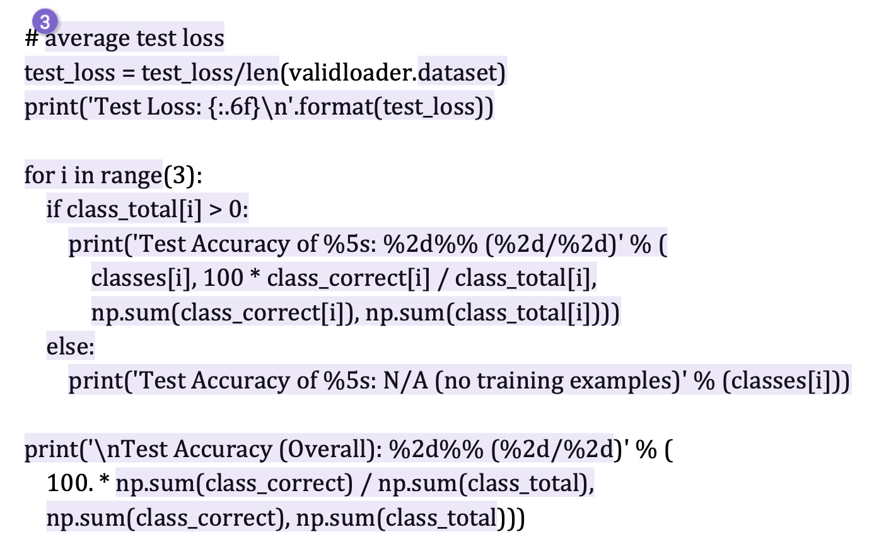
Examples of unacceptable plagiarism

Slide 13
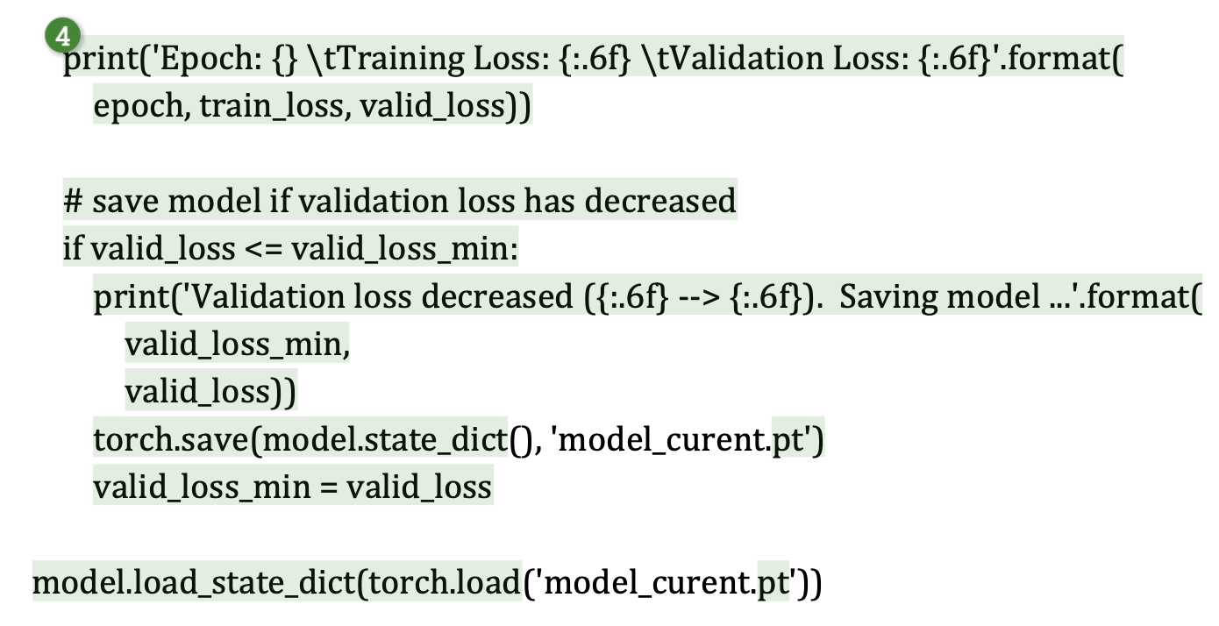
Examples of unacceptable plagiarism

Slide 14
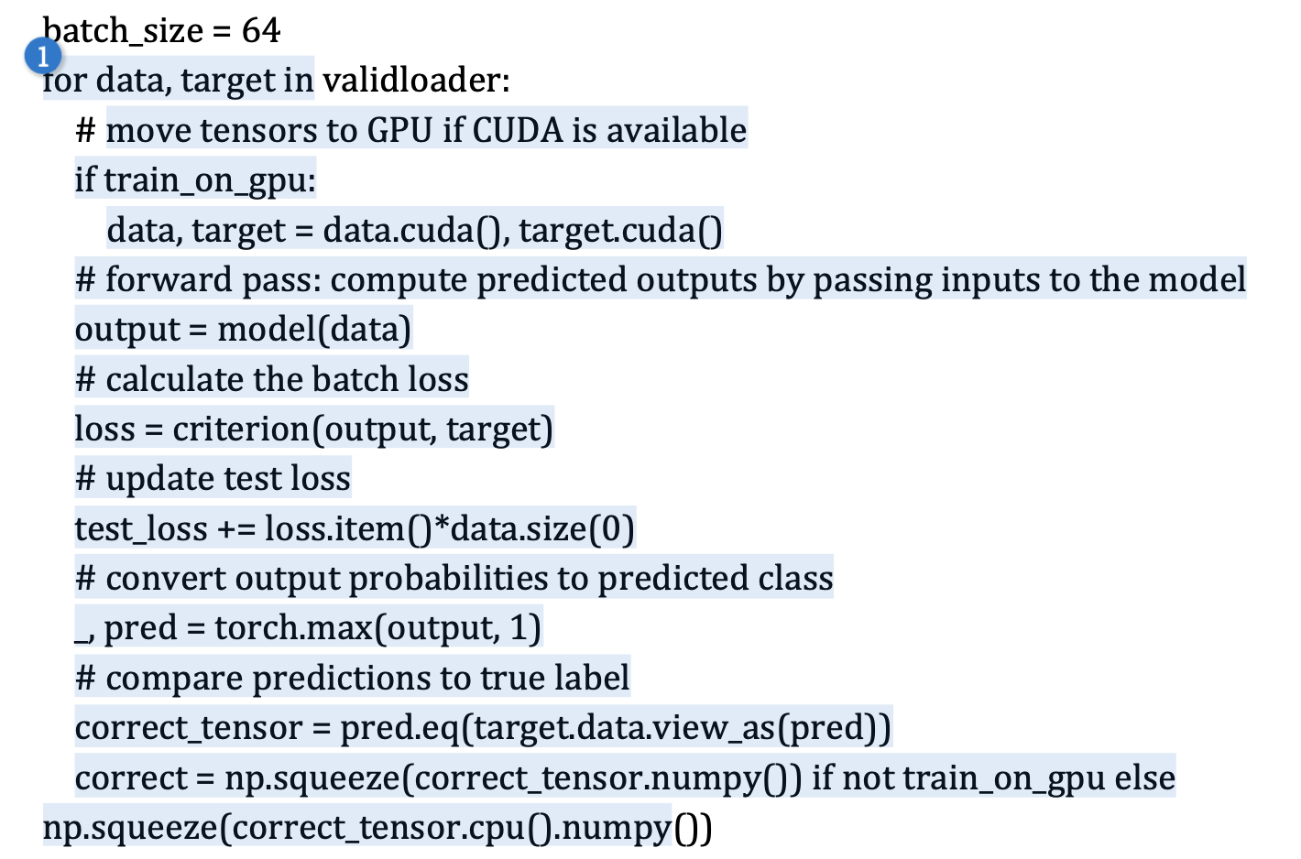
Examples of unacceptable plagiarism

Slide 15
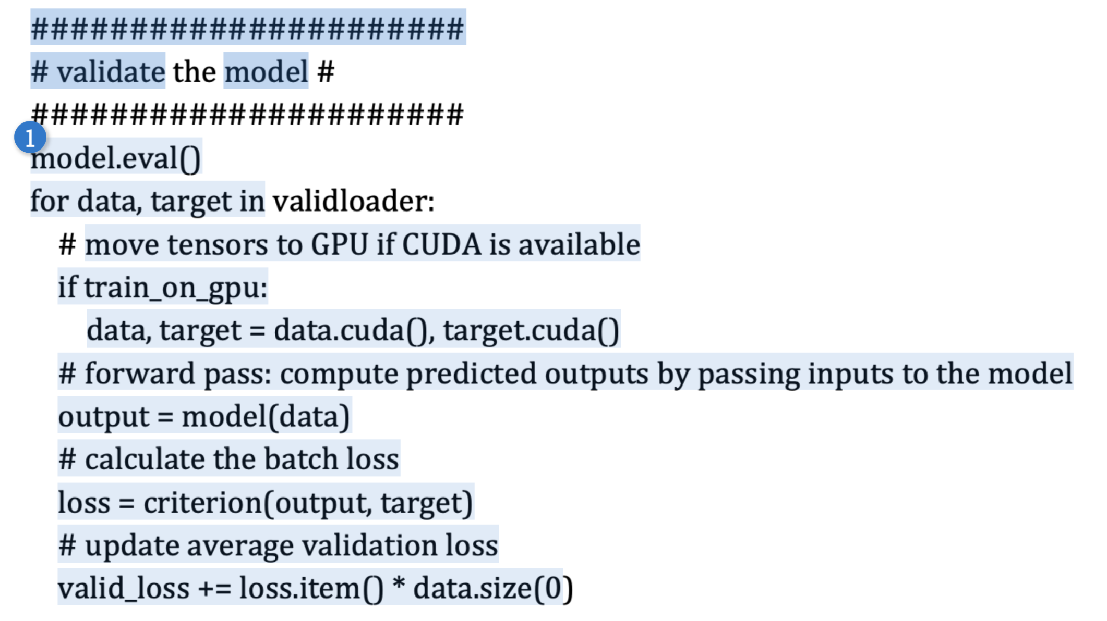
Examples of unacceptable plagiarism

Slide 16
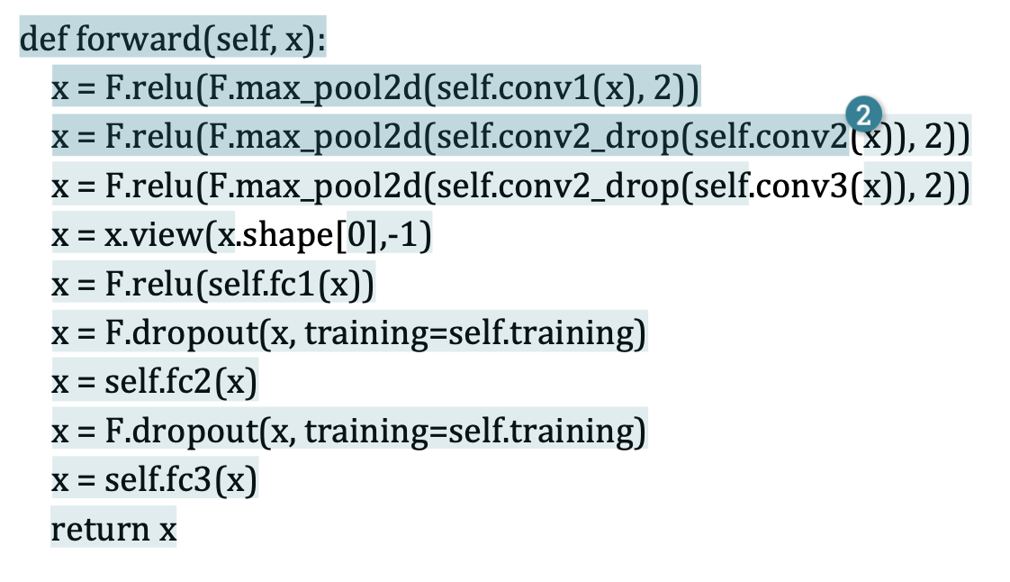
Examples of unacceptable plagiarism

Slide 17
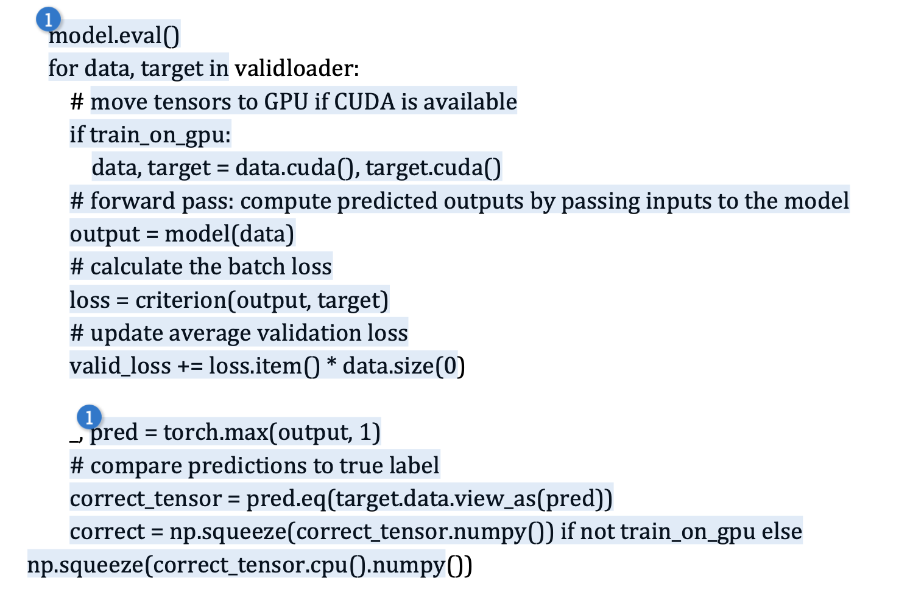
Examples of unacceptable plagiarism

Slide 18
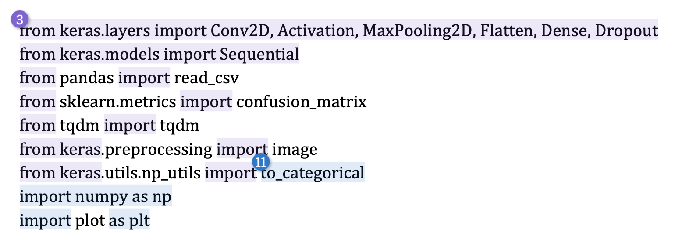
Examples of acceptable code

Slide 19
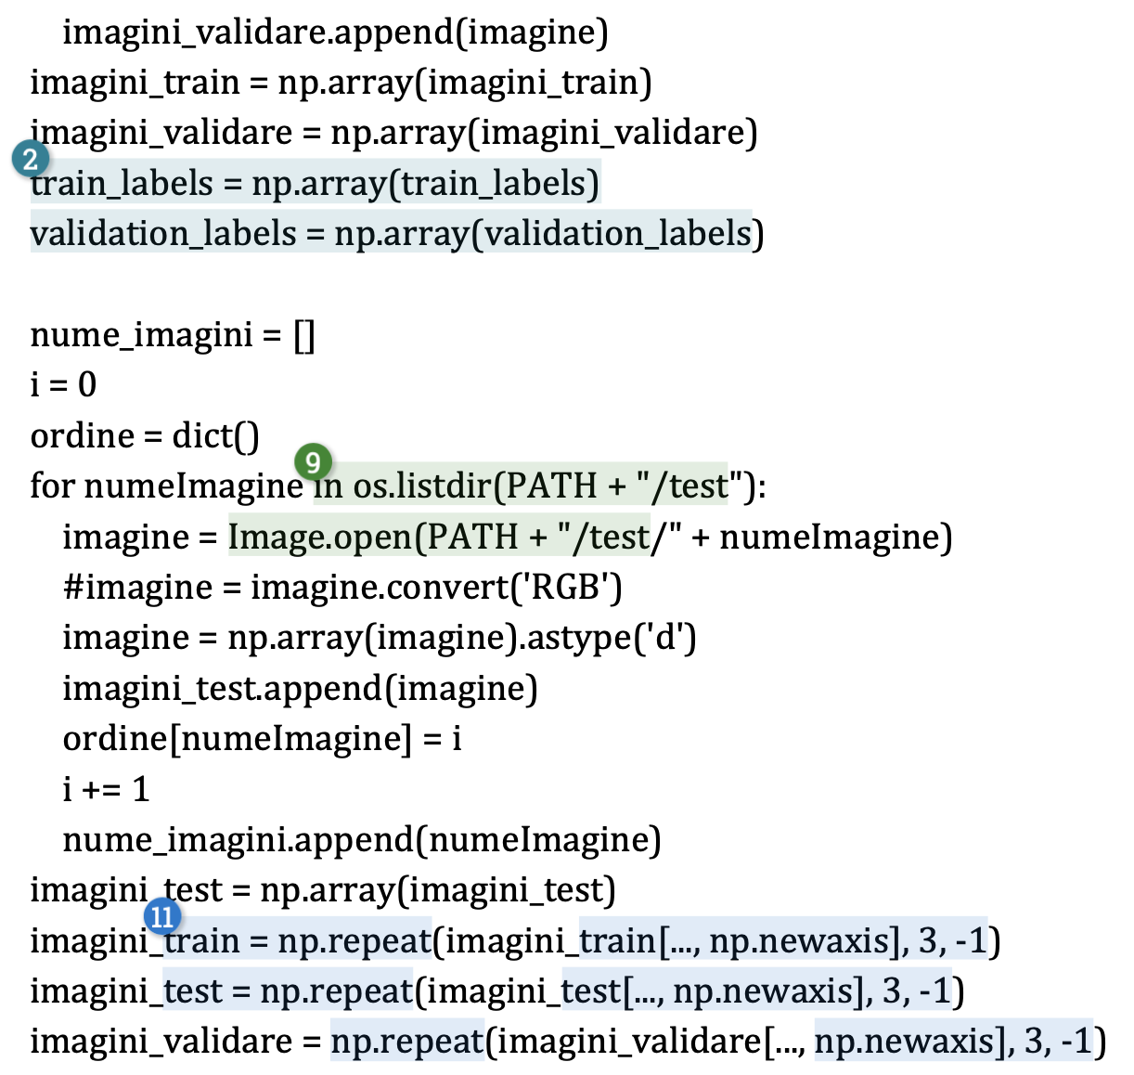
Examples of acceptable code

Slide 20
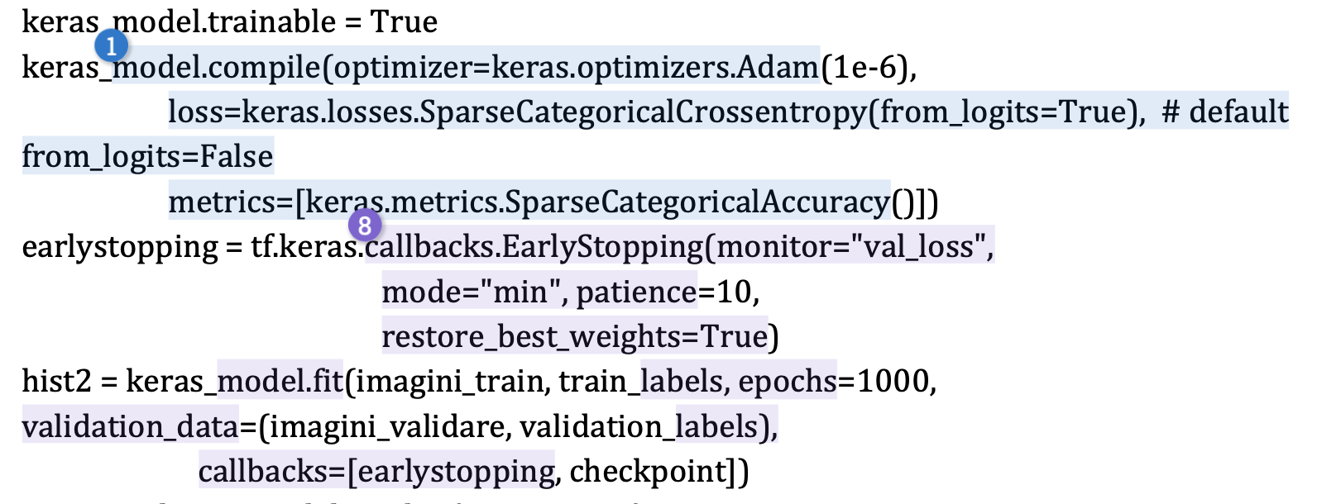
Examples of acceptable code

Slide 21
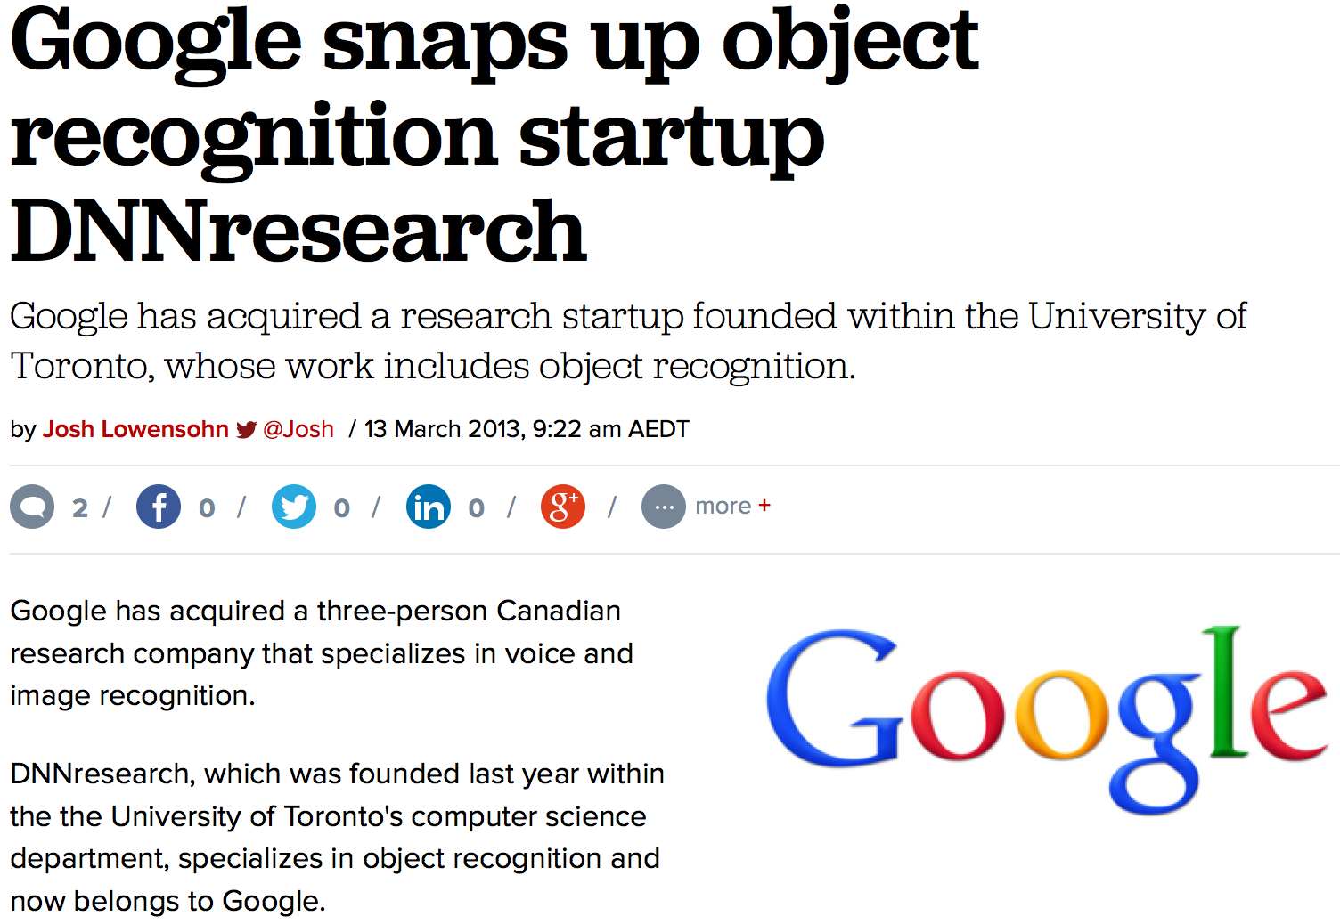
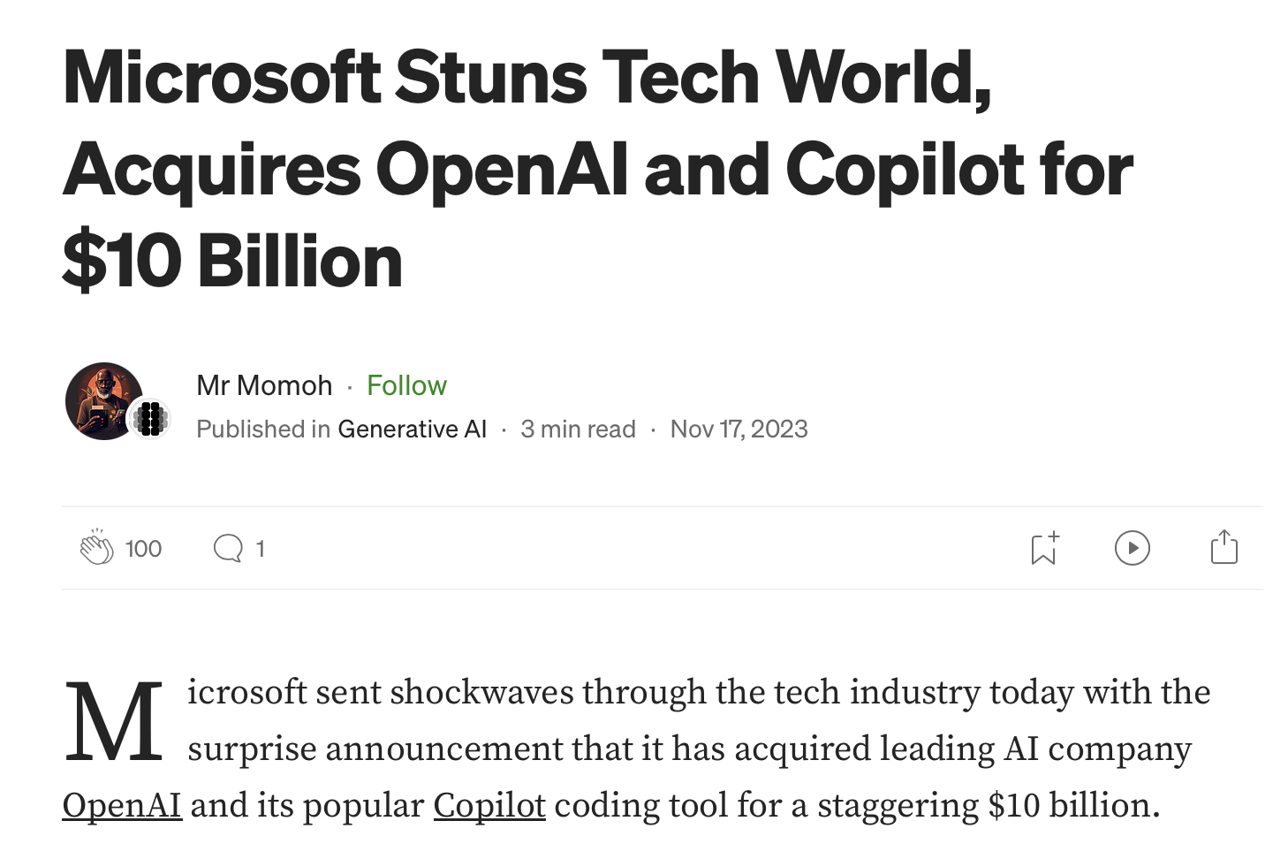
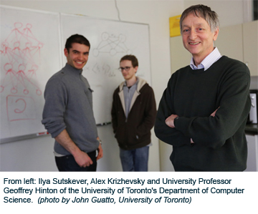
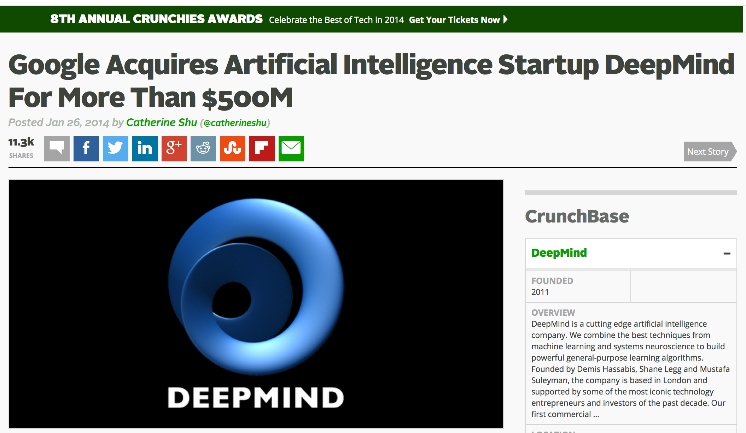
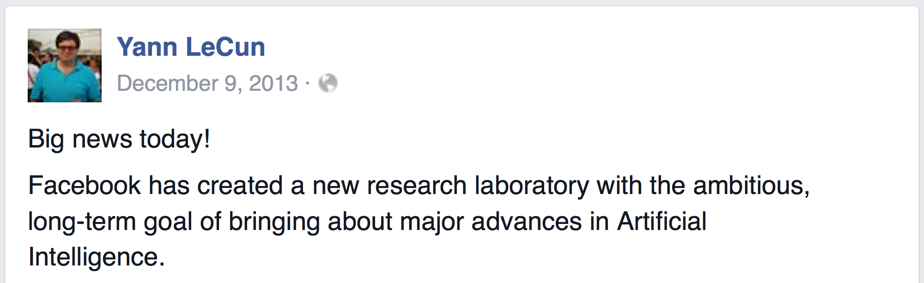
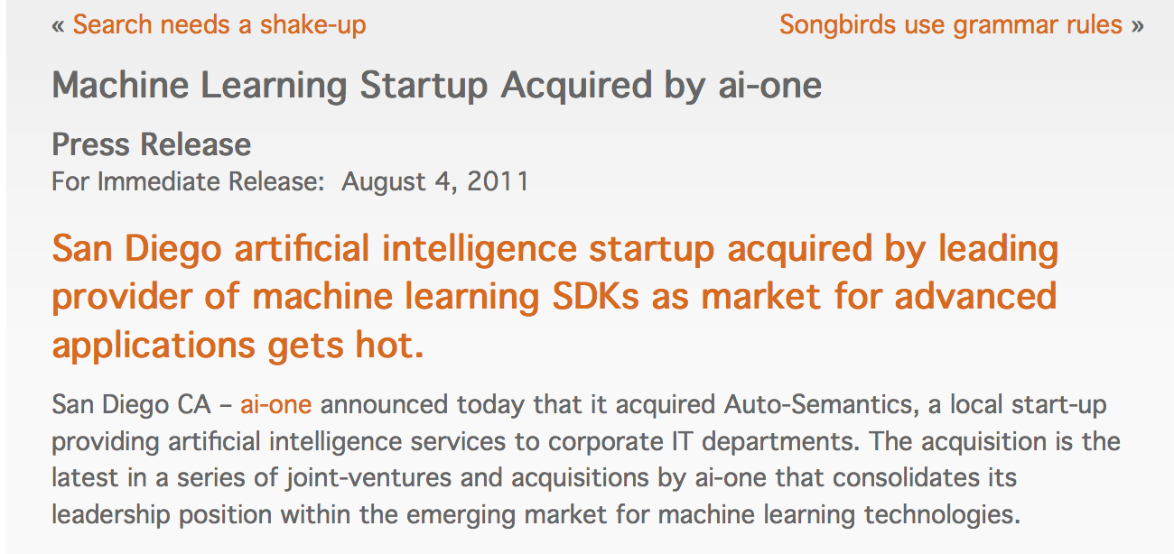
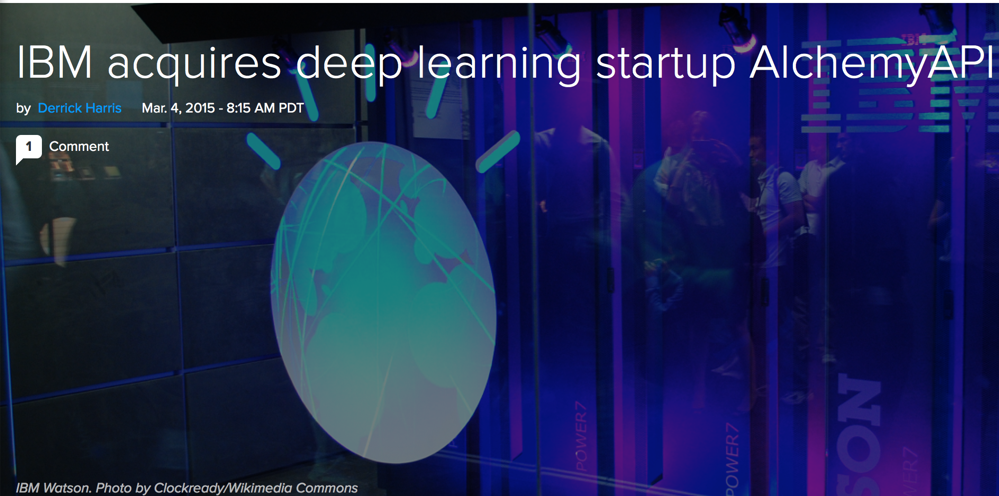
Acquisitions

Slide 22
Topics in Practical ML
Basics of Statistical Learning
Loss function, MLE, MAP, Bayesian estimation, bias-variance tradeoff, overfitting, regularization, cross-validation
Supervised Learning
Nearest Neighbors, Naïve Bayes, Logistic Regression, Support Vector Machines, Kernels, Neural Networks, Decision Trees
Ensemble Methods
Unsupervised Learning
Clustering: k-means, Gaussian mixture models, EM
Dimensionality reduction: PCA, SVD, LDA
Visuzalization: t-SNE
Perception
Applications to Vision, Natural Language Processing

Slide 23
What is Machine Learning?
“the acquisition of knowledge or skills through experience, study, or by being taught”

Slide 24
What is Machine Learning?
[Arthur Samuel, 1959]
Field of study that gives computers:
the ability to learn without being explicitly programmed
[Kevin Murphy] algorithms that
automatically detect patterns in data
use the uncovered patterns to predict future data or other outcomes of interest
[Tom Mitchell] algorithms that
improve their performance (P)
at some task (T)
with experience (E)

Slide 25
What is Machine Learning?
Machine Learning
Data
Understanding

Slide 26
ML in a Nutshell
Tens of thousands of machine learning algorithms
Hundreds new every year
Decades of ML research oversimplified:
All of Machine Learning:
Learn a mapping from input to output f: X → Y
e.g. X: emails, Y: {spam, not-spam}

Slide 27
Types of Learning
Supervised learning
Training data includes desired outputs
Unsupervised learning
Training data does not include desired outputs
Weakly or Semi-supervised learning
Training data includes a few desired outputs
Reinforcement learning
Rewards from sequence of actions

Slide 28
Tasks
Supervised Learning
x
Classification
y
Discrete
x
Regression
y
Continuous
Unsupervised Learning
x
Clustering
y
Discrete ID
x
Dimensionality Reduction
y
Continuous

Slide 29
Supervised Learning
x
Classification
y
Discrete

Slide 30
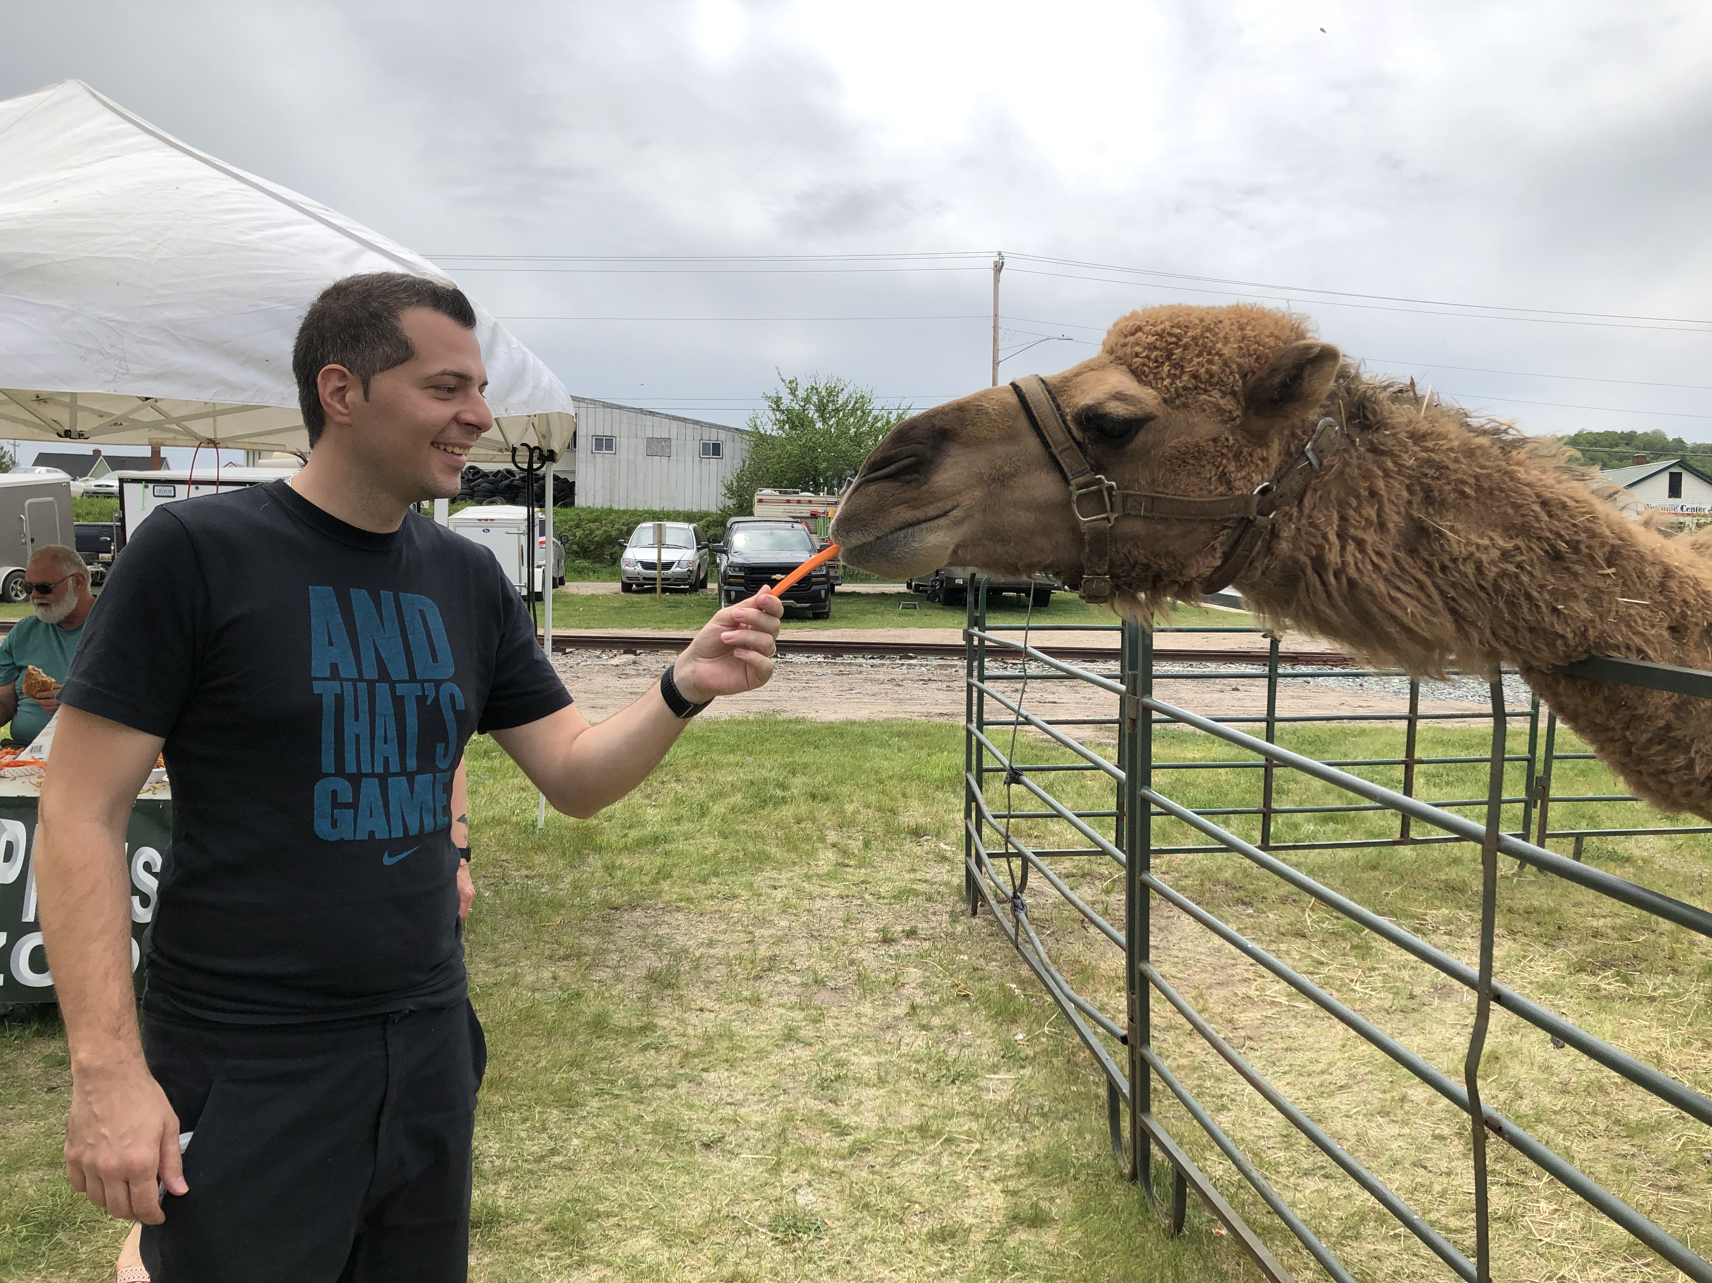
Vision: Image Classification
x
y
man
camel
carrot
car

Slide 31
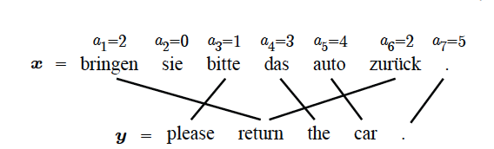
NLP: Machine Translation

Slide 32
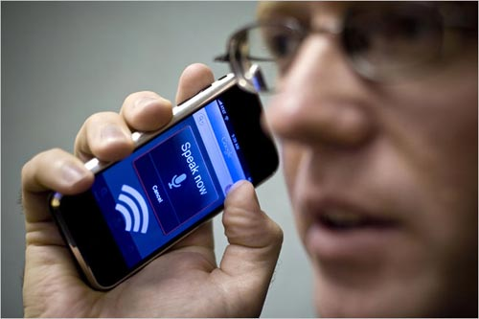
Speech: Speech2Text

Slide 33
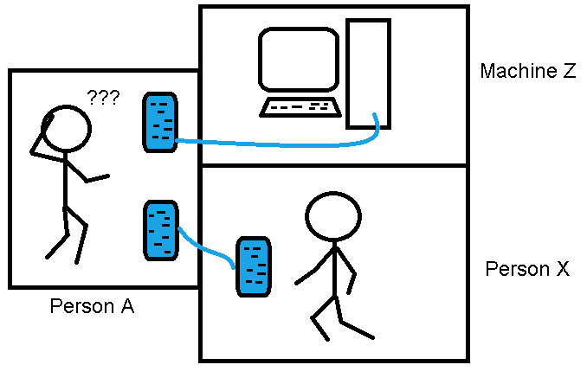
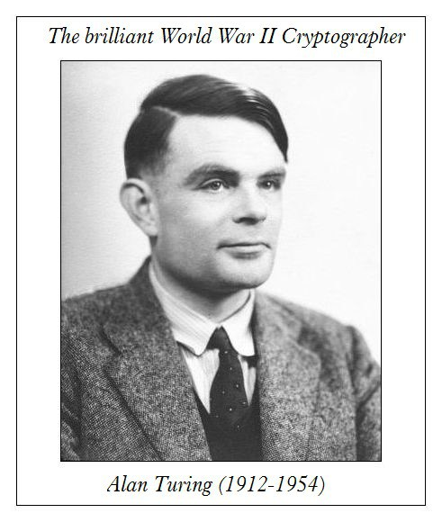
AI: Turing Test
“Can machines think”
Q: Please write me a sonnet on the subject of the Forth Bridge. A: Count me out on this one. I never could write poetry.
Q: Add 34957 to 70764. A: (Pause about 30 seconds and then give as answer) 105621.

Slide 34
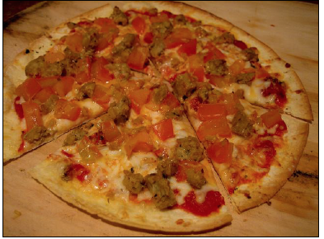
AI: Visual Turing Test
Q: How many slices of pizza are there?
A: 6
x
y

Slide 35
Supervised Learning
Input: x (images, text, emails…)
Output: y (spam or non-spam…)
(Unknown) Target Function
f: X → Y (the “true” mapping / reality)
Data
(x₁,y₁), (x₂,y₂), …, (x_{N},y_{N})
Model / Hypothesis Class
g: X → Y
y = g(x) = sign(w^{T}x)
Learning = Search in hypothesis space
Find best g in model class.

Slide 36
Synonyms
Representation Learning
Deep (Machine) Learning
Deep Neural Networks
Deep Unsupervised Learning
Simply: Deep Learning

Slide 37
So what is Deep (Machine) Learning?
A few different ideas:
(Hierarchical) Compositionality
Cascade of non-linear transformations
Multiple layers of representations
End-to-End Learning
Learning (goal-driven) representations
Learning to extract features
Distributed Representations
No single neuron “encodes” everything
Groups of neurons work together

Slide 38
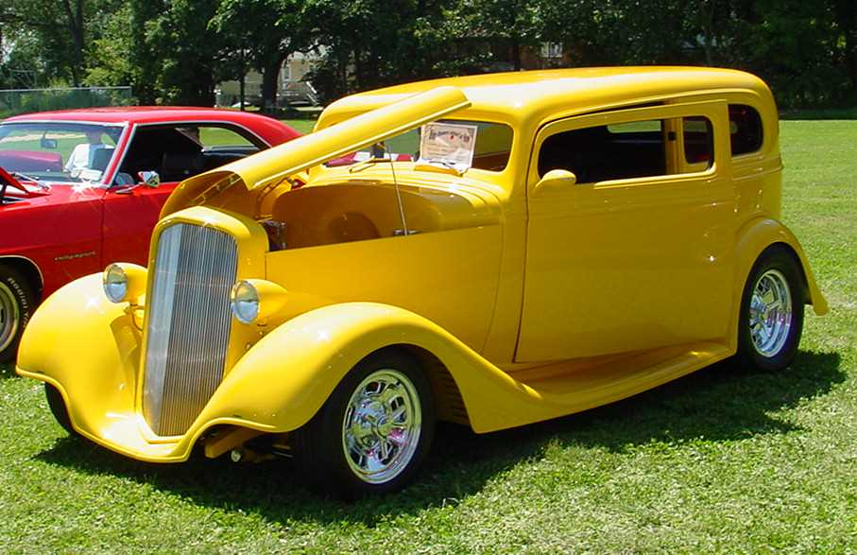
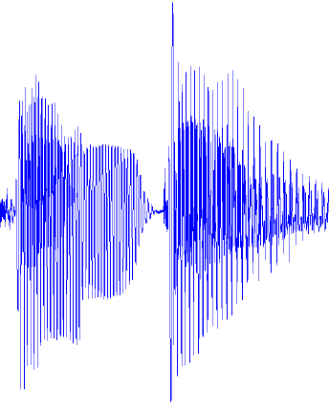
Traditional Machine Learning
VISION
hand-crafted features
SIFT/HOG
your favorite classifier
“car”
fixed
learned
SPEECH
hand-crafted features
MFCC
your favorite classifier
\ˈd ē p\
fixed
learned
NLP
hand-crafted features
bag-of-words
your favorite classifier
This burrito place
is yummy and fun!
“+”
fixed
learned

Slide 39
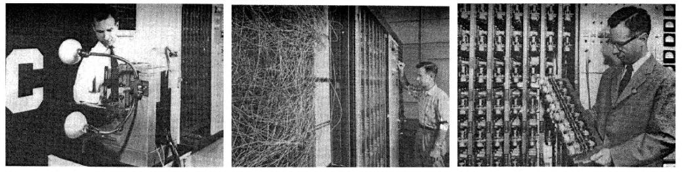
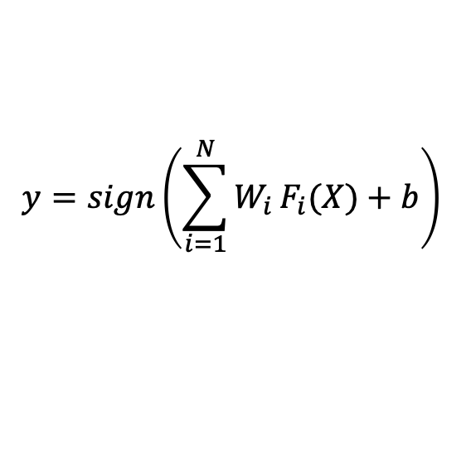
It’s an old paradigm
The first learning machine: the Perceptron
Built at Cornell in 1960
The Perceptron was a linear classifier on top of a simple feature extractor
Many practical applications of ML use glorified linear classifiers or glorified template matching
Designing a feature extractor requires considerable efforts by experts
A
Feature Extractor
W_{i}
$$y=sign\left(\sum_{i=1}^{N}{W_{i}}F_{i}(X)+b\right)$$

Slide 40
Hierarchical Compositionality
VISION
pixels
edge
texton
motif
part
object
SPEECH
sample
spectral band
formant
motif
phone
word
NLP
character
word
NP/VP/..
clause
sentence
story

Slide 41
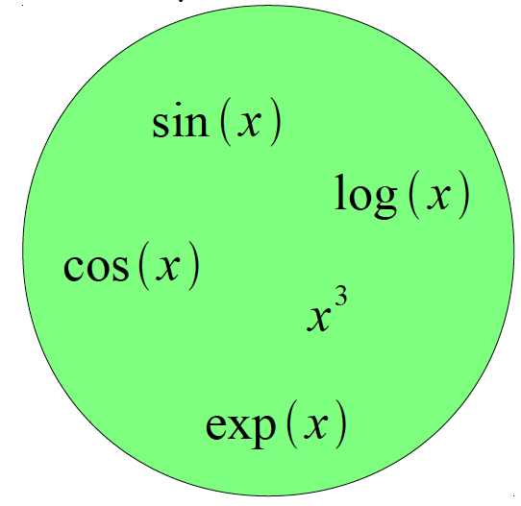
Building a Complicated Function
Given a library of simple functions
Compose into a
complicated function

Slide 42
Building A Complicated Function
Given a library of simple functions
Idea 1: Linear Combinations
Boosting
Kernels
…
Compose into a
complicate function
+

Slide 43
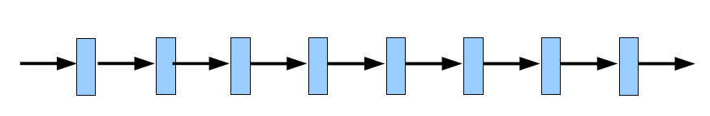
Building A Complicated Function
Given a library of simple functions
Idea 2: Compositions
Deep Learning
Grammar models
Scattering transforms…
Compose into a
complicate function

Slide 44
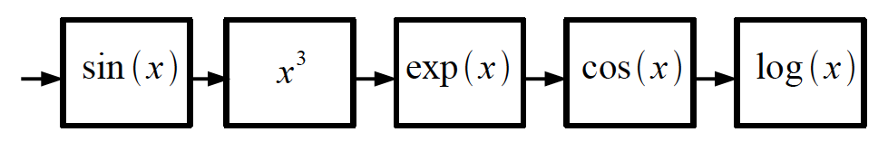
Building A Complicated Function
Given a library of simple functions
Idea 2: Compositions
Deep Learning
Grammar models
Scattering transforms…
Compose into a
complicate function

Slide 45
Deep Learning = Hierarchical Compositionality
“car”

Slide 46
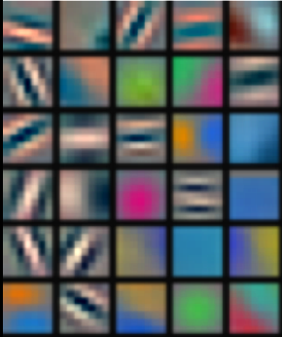
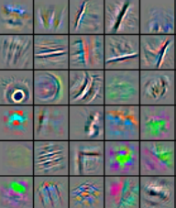
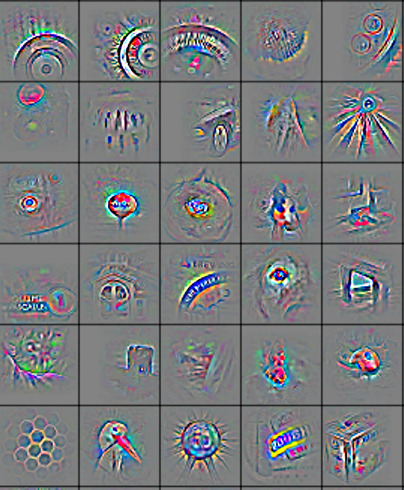
Deep Learning = Hierarchical Compositionality
Low-Level Feature
Mid-Level Feature
High-Level Feature
Trainable Classifier
“car”
Feature visualization of convolutional net trained on ImageNet from [Zeiler & Fergus 2013]

Slide 47
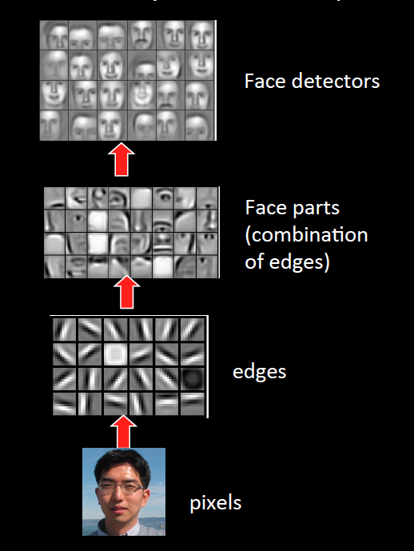
Sparse DBNs
[Lee et al. ICML ‘09]
Figure courtesy: Quoc Le

Slide 48
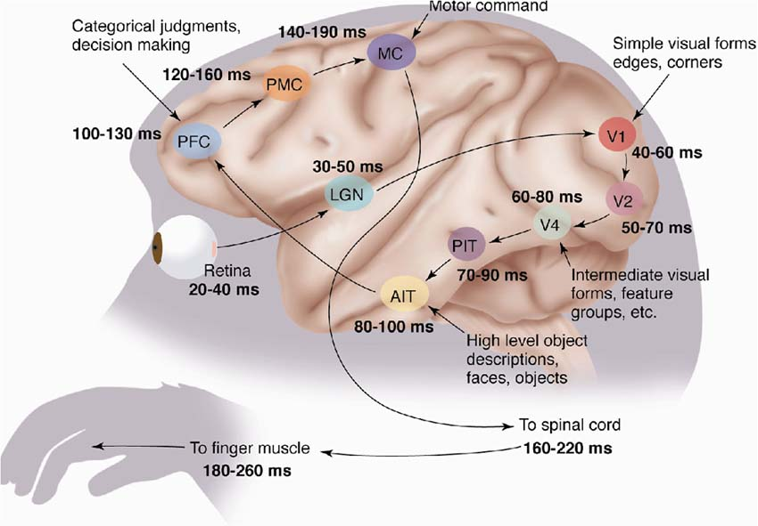
The Mammalian Visual Cortex is Hierarchical
The ventral (recognition) pathway in the visual cortex
[picture from Simon Thorpe]
Notes:
lateral geniculate nucleus (LGN), Anterior inferotemporal cortex (aIT), Posterior inferotemporal cortex (pIT), prefrontal cortex (PFC), premotor cortex (PMC)

Slide 49
So what is Deep (Machine) Learning?
A few different ideas:
(Hierarchical) Compositionality
Cascade of non-linear transformations
Multiple layers of representations
End-to-End Learning
Learning (goal-driven) representations
Learning to extract features
Distributed Representations
No single neuron “encodes” everything
Groups of neurons work together

Slide 50
Traditional Machine Learning
VISION
hand-crafted features
SIFT/HOG
your favorite classifier
“car”
fixed
learned
SPEECH
hand-crafted features
MFCC
your favorite classifier
\ˈd ē p\
fixed
learned
NLP
hand-crafted features
Bag-of-words
your favorite classifier
This burrito place
is yummy and fun!
“+”
fixed
learned

Slide 51
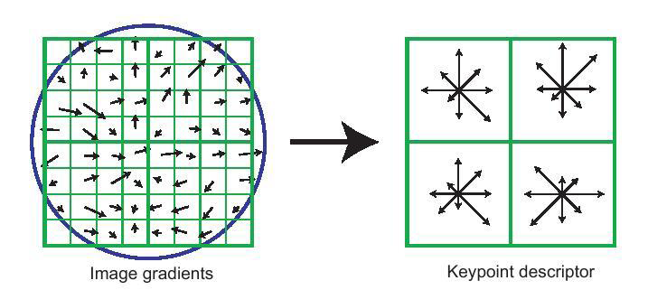
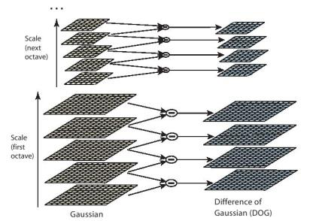
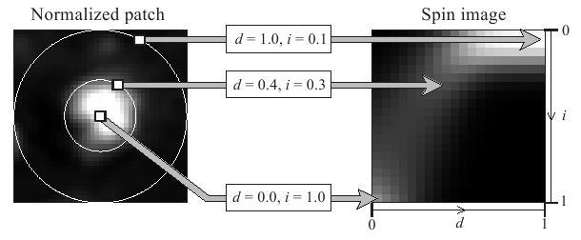
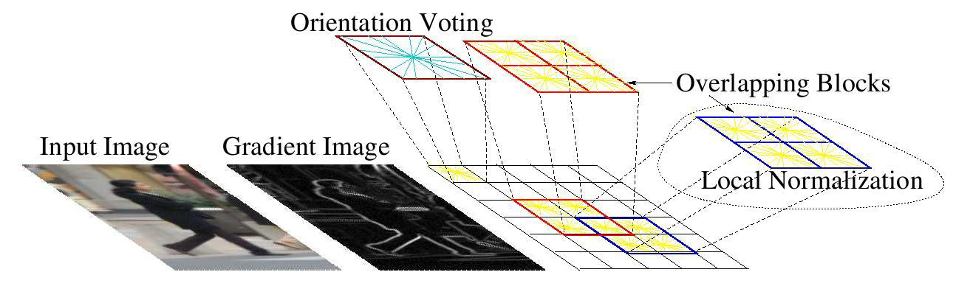
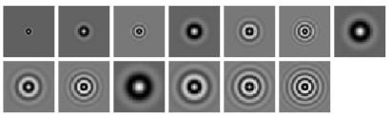
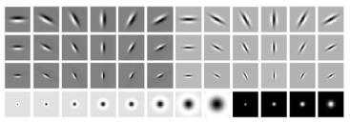
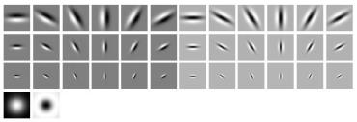
Feature Engineering
SIFT
Spin Images
HoG
Textons
and many many more….

Slide 52
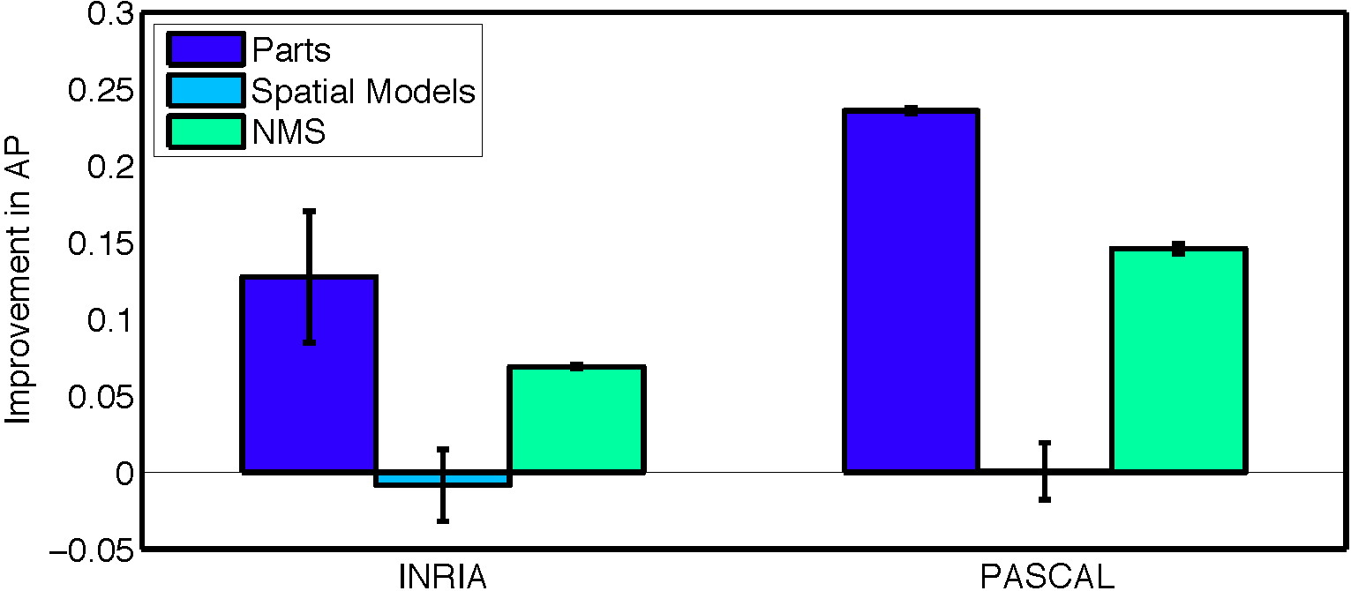
What are the engineering bottlenecks?
Ablation studies on DPM [Parikh & Zitnick, CVPR10]
Replace every “part” in the model with a human
Key takeaway: “parts” or features are the most important!

Slide 53
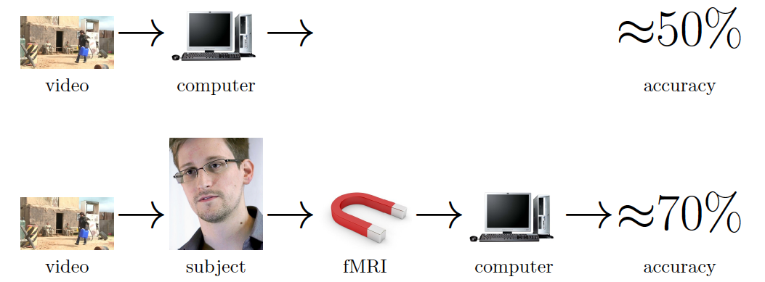
Seeing is worse than believing
[Barbu et al. ECCV14]

Slide 54
Traditional Machine Learning
“Learned”
VISION
SIFT/HOG
K-Means/
pooling
classifier
“car”
fixed
unsupervised
supervised
SPEECH
MFCC
Mixture of
Gaussians
classifier
\ˈd ē p\
fixed
unsupervised
supervised
NLP
Parse Tree
Syntactic
n-grams
classifier
This burrito place
is yummy and fun!
“+”
fixed
unsupervised
supervised

Slide 55
Deep Learning = End-to-End Learning
“Learned”
VISION
SIFT/HOG
K-Means/
pooling
classifier
“car”
fixed
unsupervised
supervised
SPEECH
MFCC
Mixture of
Gaussians
classifier
\ˈd ē p\
fixed
unsupervised
supervised
NLP
Parse Tree
Syntactic
n-grams
classifier
This burrito place
is yummy and fun!
“+”
fixed
unsupervised
supervised

Slide 56
Deep Learning = End-to-End Learning
A hierarchy of trainable feature transforms
Each module transforms its input representation into a higher-level one.
High-level features are more global and more invariant
Low-level features are shared among categories
Trainable Feature-Transform / Classifier
Trainable Feature-Transform / Classifier
Trainable Feature-Transform / Classifier
Learned Internal Representations

Slide 57
“Shallow” vs Deep Learning
“Shallow” models
Deep models
hand-crafted
Feature Extractor
“Simple” Trainable
Classifier
fixed
learned
Trainable Feature-Transform / Classifier
Trainable Feature-Transform / Classifier
Trainable Feature-Transform / Classifier
Learned Internal Representations

Slide 58
Do we really need deep models?

Slide 59
So what is Deep (Machine) Learning?
A few different ideas:
(Hierarchical) Compositionality
Cascade of non-linear transformations
Multiple layers of representations
End-to-End Learning
Learning (goal-driven) representations
Learning to extract features
Distributed Representations
No single neuron “encodes” everything
Groups of neurons work together

Slide 60
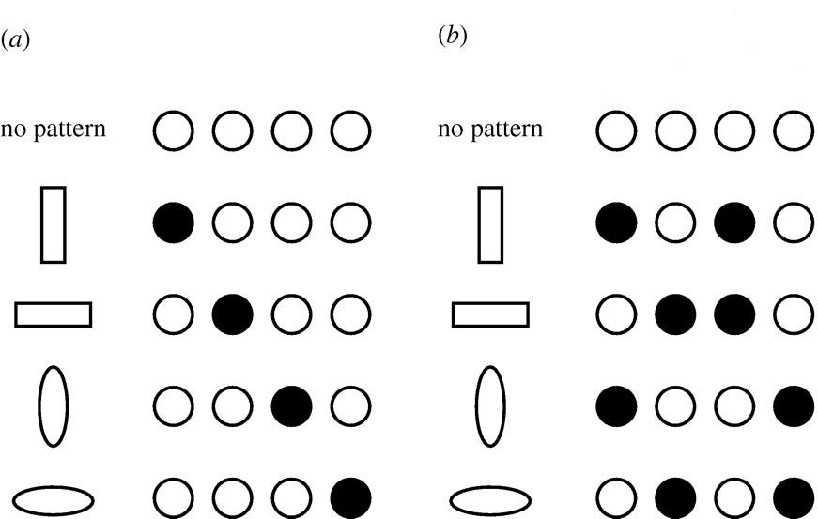
Distributed Representations Toy Example
Local vs Distributed

Slide 61
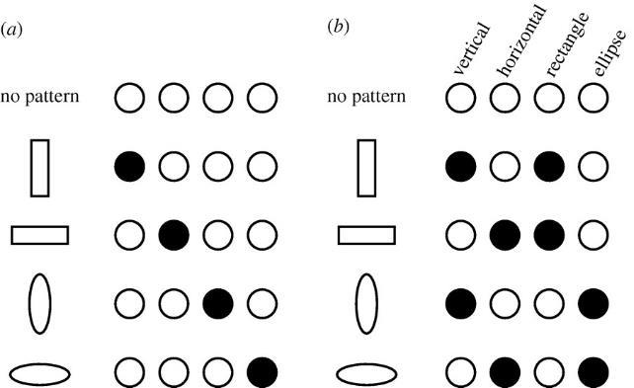
Distributed Representations Toy Example
Can we interpret each dimension?

Slide 62
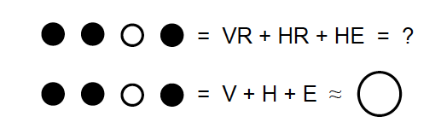
Power of distributed representations!
Local
Distributed

Slide 63
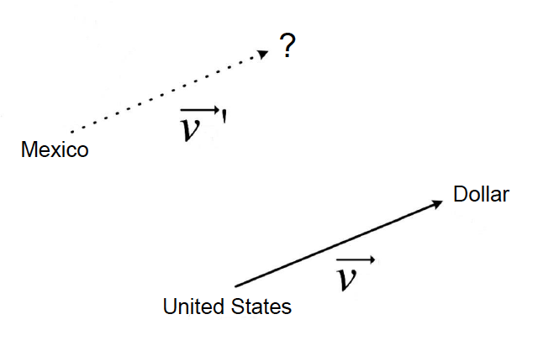
Power of distributed representations!
United States:Dollar :: Romania:?
Romania

Slide 64

Power of distributed representations!
Example: all face images of a person
1000x1000 pixels = 1,000,000 dimensions
But the face has 3 Cartesian coordinates and 3 Euler angles
And humans have less than about 50 muscles in the face
Hence the manifold of face images for a person has <56 dimensions
The perfect representations of a face image:
Its coordinates on the face manifold
Its coordinates away from the manifold
Ideal
Feature
Extractor
Face/not face
Pose
Lighting
Expression
-----

Slide 65
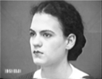
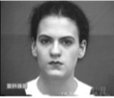
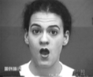
Power of distributed representations!
The Ideal Disentangling Feature Extractor
View
Pixel n
Ideal
Feature
Extractor
Pixel 2
Expression
Pixel 1

Slide 66

Distributed Representations
Q: What objects are in the image? Where?

Slide 67

Power of distributed representations!

Slide 68
So what is Deep (Machine) Learning?
A few different ideas:
(Hierarchical) Compositionality
Cascade of non-linear transformations
Multiple layers of representations
End-to-End Learning
Learning (goal-driven) representations
Learning to feature extraction
Distributed Representations
No single neuron “encodes” everything
Groups of neurons work together

Slide 69
Benefits of Deep/Representation Learning
(Usually) Better Performance
“Because gradient descent is better than you” Yann LeCun
New domains without “experts”
RGBD
Multi-spectral data
Gene-expression data
Unclear how to hand-engineer

Slide 70

“Expert” intuitions can be misleading
“Every time I fire a linguist, the performance of our speech recognition system goes up”
Fred Jelinik, IBM ’98
“Maybe the molecule didn’t go to graduate school”
Will Welch defending the success of his approximate molecular screening algorithm, given that he’s a computer scientist, not a chemist
Database Screening for HIV Protease Ligands: The Influence of Binding-Site Conformation and Representation on Ligand Selectivity", Volker Schnecke, Leslie A. Kuhn, Proceedings of the Seventh International Conference on Intelligent Systems for Molecular Biology, Pages 242-251, AAAI Press, 1999.

Slide 71
Problems with Deep Learning
Problem#1: Non-Convex! Non-Convex! Non-Convex!
Depth>=3: most losses non-convex in parameters
Theoretically, all bets are off
Leads to stochasticity
different initializations → different local minima
Standard response #1
“Yes, but all interesting learning problems are non-convex”
For example, human learning
Order matters → reliance on heuristic → non-convexity
Standard response #2
“Yes, but it often works!”

Slide 72
Problems with Deep Learning
Problem#2: Hard to track down what’s failing
Pipeline systems have “oracle” performances at each step
In end-to-end systems, it’s hard to know why things are not working

Slide 73



Problems with Deep Learning
Problem#2: Hard to track down what’s failing
[Fang et al. CVPR15]
[Vinyals et al. CVPR15]
Pipeline
End-to-End

Slide 74
Problems with Deep Learning
Problem#2: Hard to track down what’s failing
Pipeline systems have “oracle” performances at each step
In end-to-end systems, it’s hard to know why things are not working
Standard response #1
Tricks of the trade: visualize features, add losses at different layers, pre-train to avoid degenerate initializations…
“We’re working on it”
Standard response #2
“Yes, but it often works!”

Slide 75
Problems with Deep Learning
Problem#2: Hard to track down what’s failing
There are methods to
visualize the features, e.g.:
GradCAM
GradCAM++

Slide 76
Problems with Deep Learning
Problem#3: Lack of easy reproducibility
Direct consequence of stochasticity & non-convexity
Standard response #1
It’s getting much better
Standard toolkits/libraries/frameworks now available
TensorFlow, PyTorch, Keras, Caffe, Theano
Standard response #2
“Yes, but it often works!”

Slide 77

Yes it works, but how?

Slide 78


Slide 79


Slide 80


Slide 81


Slide 82


Slide 83


Slide 84


Slide 85


Slide 86


Slide 87

ImageNet Large Scale Visual Recognition Challenge (ILSVRC)
Classification:
1000 object classes 1.4M/50k/100k images
Detection:
200 object classes 400k/20k/40k images
Dalmatian
http://image-net.org/challenges/LSVRC/{2010,…,2014}

Slide 88



Data Enabling Richer Models
[Krizhevsky et al. NIPS12]
54 million parameters; 8 layers (5 conv, 3 fully-connected)
Trained on 1.4M images in ImageNet
Better Regularization (Dropout)
Input Image
1k output units
Convolution Layer + Non-Linearity
Pooling Layer
Convolution Layer + Non-Linearity
Pooling Layer
Fully-Connected MLP

Slide 89

ImageNet Classification 2012
[Krizhevsky et al. NIPS12]: 15.4% error
Next best team: 26.2% error

Slide 90

Other Domains & Applications
Vision
Natural Language Processing
Speech
Robotics
Game Playing
Medical Imaging
Retail
Surveillance
Insurance
Many others

Slide 91
Why are things working today?
More compute power
GPUs are ~50x faster
More data
10⁸ samples (compared to 10³ in 1990s)
Better algorithms/models/regularizers
Dropout
ReLU
Batch-Normalization
…

Slide 92
THE SPACE OF
MACHINE LEARNING METHODS

Slide 93
Recurrent Neural Net
Boosting
Convolutional Neural Net
Perceptron
Neural Net
SVM
Deep (sparse/denoising) Autoencoder
Autoencoder
Sparse Coding
GMM
Deep Belief Net
Restricted BM
BayesNP
Disclaimer: showing only a subset of the known methods

Slide 94
Recurrent Neural Net
Boosting
SHALLOW
Convolutional Neural Net
Perceptron
Neural Net
SVM
Deep (sparse/denoising) Autoencoder
Autoencoder
Sparse Coding
GMM
Deep Belief Net
Restricted BM
BayesNP
DEEP

Slide 95
Recurrent Neural Net
Boosting
SHALLOW
Convolutional Neural Net
Perceptron
Neural Net
SUPERVISED
SVM
Deep (sparse/denoising) Autoencoder
UNSUPERVISED
Autoencoder
Sparse Coding
GMM
Deep Belief Net
Restricted BM
BayesNP
DEEP

Slide 96
Recurrent Neural Net
Boosting
SHALLOW
Convolutional Neural Net
Perceptron
Neural Net
SUPERVISED
SVM
Deep (sparse/denoising) Autoencoder
UNSUPERVISED
Autoencoder
PROBABILISTIC
Sparse Coding
GMM
Deep Belief Net
Restricted BM
BayesNP
DEEP

Slide 97
Main types of deep architectures
Neural Nets
Conv Nets
Hierar. Sparse Coding
Deconv Nets
Feed-forward
Feed-back
input
input
Stacked Auto-encoders
BiLSTM
Recurrent Neural Nets
Recursive Nets
LSTM
Bi-directional
Recurrent
input
input

Slide 98
Focus of this class
Neural Nets
Conv Nets
Hierar. Sparse Coding
Deconv Nets
Feed-forward
Feed-back
input
input
Stacked Auto-encoders
BiLSTM
Recurrent Neural Nets
Recursive Nets
LSTM
Bi-directional
Recurrent
input
input

Slide 99
Main types of learning protocols
Purely supervised
Backprop + SGD
Good when there is lots of labeled data.
Layer-wise unsupervised + supervised linear classifier
Train each layer in sequence using regularized auto-encoders or RBMs
Hold fix the feature extractor, train linear classifier on features
Good when labeled data is scarce but there is lots of unlabeled data.
Layer-wise unsupervised + supervised backprop
Train each layer in sequence
Backprop through the whole system
Good when learning problem is very difficult.

Slide 100
Focus of this class
Purely supervised
Backprop + SGD
Good when there is lots of labeled data.
Layer-wise unsupervised + supervised linear classifier
Train each layer in sequence using regularized auto-encoders or RBMs
Hold fix the feature extractor, train linear classifier on features
Good when labeled data is scarce but there is lots of unlabeled data.
Layer-wise unsupervised + supervised backprop
Train each layer in sequence
Backprop through the whole system
Good when learning problem is very difficult.

Slide 101


Slide 102


